Slide 1

Hardhat Enterprises
Project Status Update
Trimester 1 2023 24/4/2023
Notes:
Good morning everyone. I am Jerome from Fortify and I will be presenting the project status update for Hardhat Enterprises

Slide 2
Hardhat Projects
Fortify
AppAttack
NASA Protocol Exploits
Pen Testing GUI
Breaking Captcha

Slide 3

Fortify Progress
Now, we are working on 4 parallels:
Development: using Figma to create a smoother and more in-depth view of how stakeholders will interact with the application
Research: are progressing well with further work being done in key areas
Matchmaking: Python script created with initial results. Further refinement is planned and in progress
Education: This stream is a completely new stream with half of the expected work done and a formal education program is to be completed next trimester
Notes:
New Logo:

Slide 4
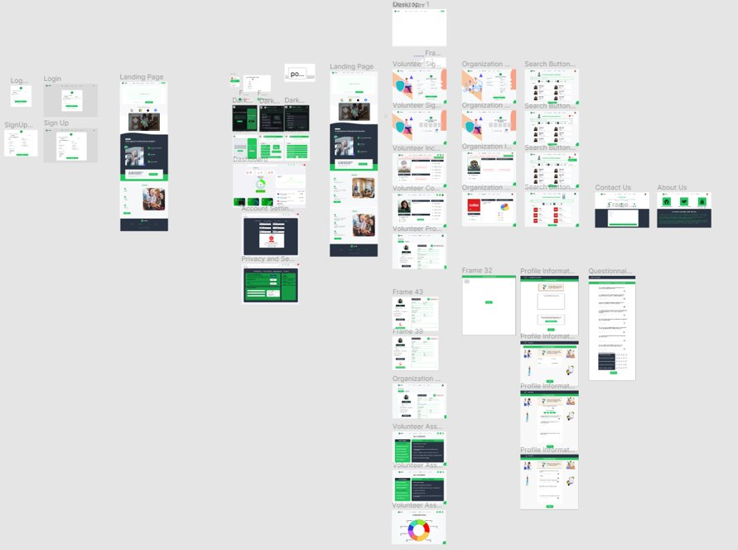
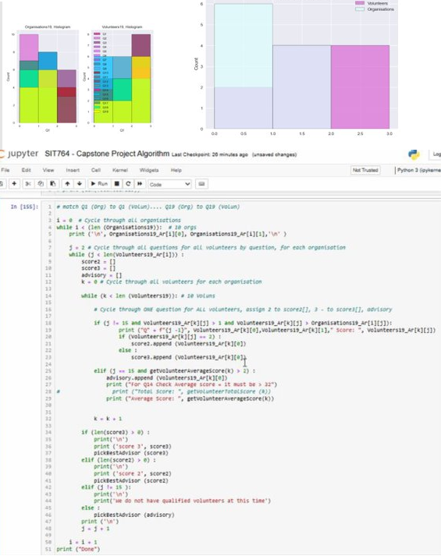
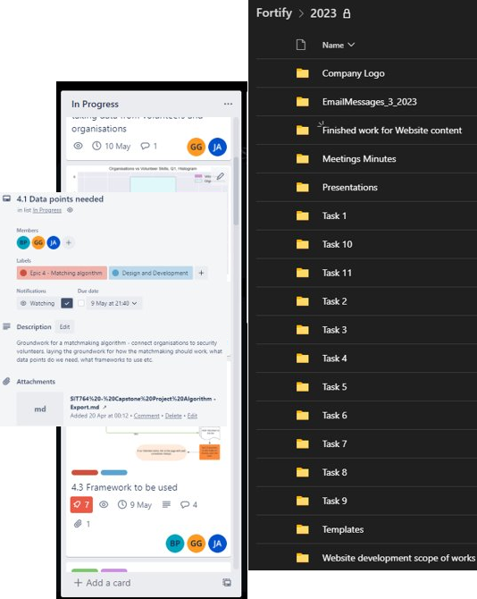
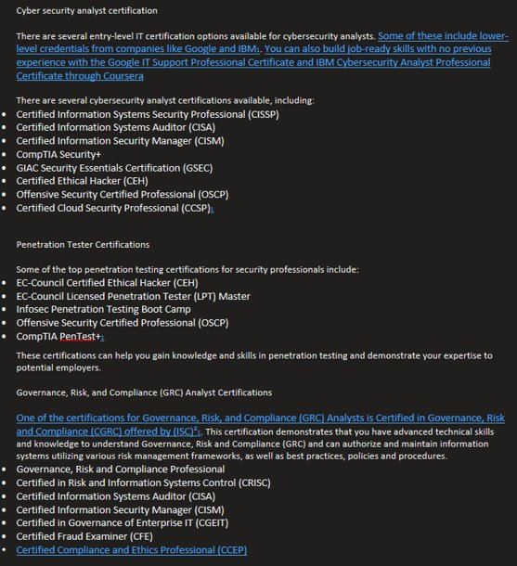
Development
Matchmaking
Research
Education
Notes:
Here's a bit of a collage the work that has been done for Fortify
Dev: Further work has been done to the wireframe by using Figma to create a smoother and more in-depth view of how stakeholders will interact with the application.
Research: Tasks are populated in Teams Channel folder with allocation of tasks through Trello board
Matchmaking: Draft graphical representation produced to provide visualization of matchmaking With Further refinement is planned and in progress
Education: New stream with useful guides for cyber sec students like the document that is part of the education stream outlining which certifications one should aim for when first started out and advanced certifications to keep their focus

Slide 5
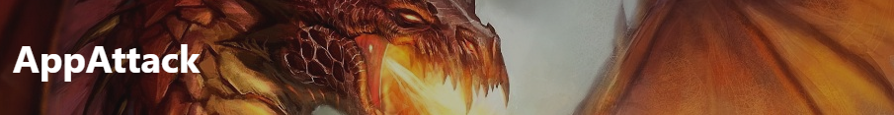
AppAttack Progress
Found Bugs & Vulnerabilities (under verification)
Mentor Sessions
Research & Resources (Kali Purple, ChatGPT, GCP, AWS)
Gopher & Databytes meetings (Ongoing)
Future planning, restructuring & survey (WIP)
Red/blue/purple team classification
Updating our Findings Template
Ethical Agreement Form (WIP)
Notes:
AppAttack has identified bugs & vulnerabilities and are currently under verification.
We've recently introduced a weekly mentoring session to help guide team-members in place of our 2nd meeting.
We have completed and ongoing research documentation such as Kali purple, GCP, ChatGPT and more recently AWS.
AppAttack has been conducting meetings with other company's such as Gopher and Databytes to assess new projects to work on in next trimester Based on these meetings we are planning what tools/resources we will need, how we are going to structure the teams and based on our project wide survey, take on the feedback to improve the onboarding experience.
We will include a red/blue & purple team classification document for more defined roles going into T2 2023.
We are redesigning our finding templates to better suit new projects in next trimester Finally we are putting together an official Ethical Agreement form when we onboard new team-members, to reinforce ethical safety practices when handling others projects.

Slide 6

Progress Update
Static Analysis Stream:
Continued documenting analysis including observations and recommendations in Static Analysis Reports
Continued validating both true and false positive vulnerabilities
On track to finalize analysis for all high impacting issues identified for the Bundle Protocol v7.
Dynamic Analysis Stream:
Slow progress due to limited domain knowledge and challenges with setting up environments for fuzzing
New environments set up, base code for APIs and fuzzing now developed
On track to have a functioning fuzzer for Bundle Protocol
Notes:
Static Analysis Stream
Progress: Outcomes for this stream have been steady with the framework established last trimester for members of the cohort to work within. The scope of work has been clearly outlined, and members have been creating documents containing detailed analysis, with observations and recommendations in the form of Static Analysis Reports. Alongside the documentation, the team is continuously validating both true and false positive vulnerabilities in an effort to collate numbers of vulnerabilities for the Dynamic Stream to work with.
Forecast: The team is forecasted to have a finalized set of Static Analysis Reports for all high impacting issues identified for the Bundle Protocol v7.
Dynamic Analysis Team
Progress: Outcomes have been slow for this stream due to limitations in domain knowledge and the challenges of setting up environments for use in fuzzing. Fortunately, with the environmental changes implemented last trimester, together with code bases being developed for an API using the bundle protocol and a fuzzing script, the team is now set up for success.
Forecast: The team is forecasted to have a fully functional fuzzer for the Bundle Protocol by trimester end with the aim to begin development of a fuzzer for another protocol.

Slide 7
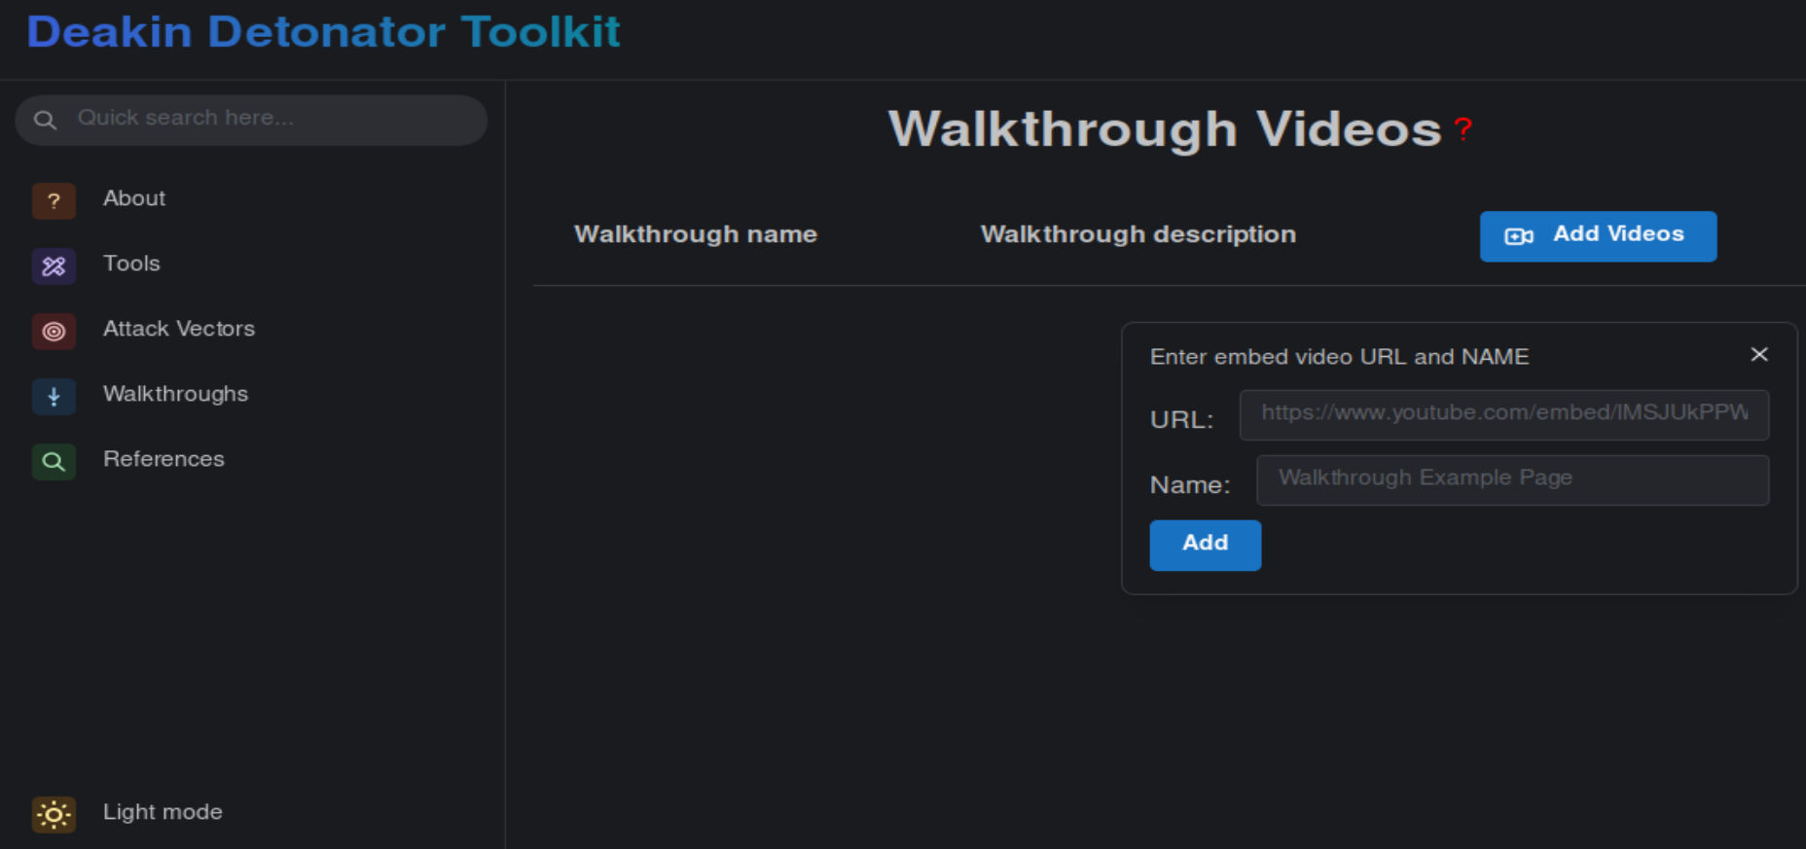

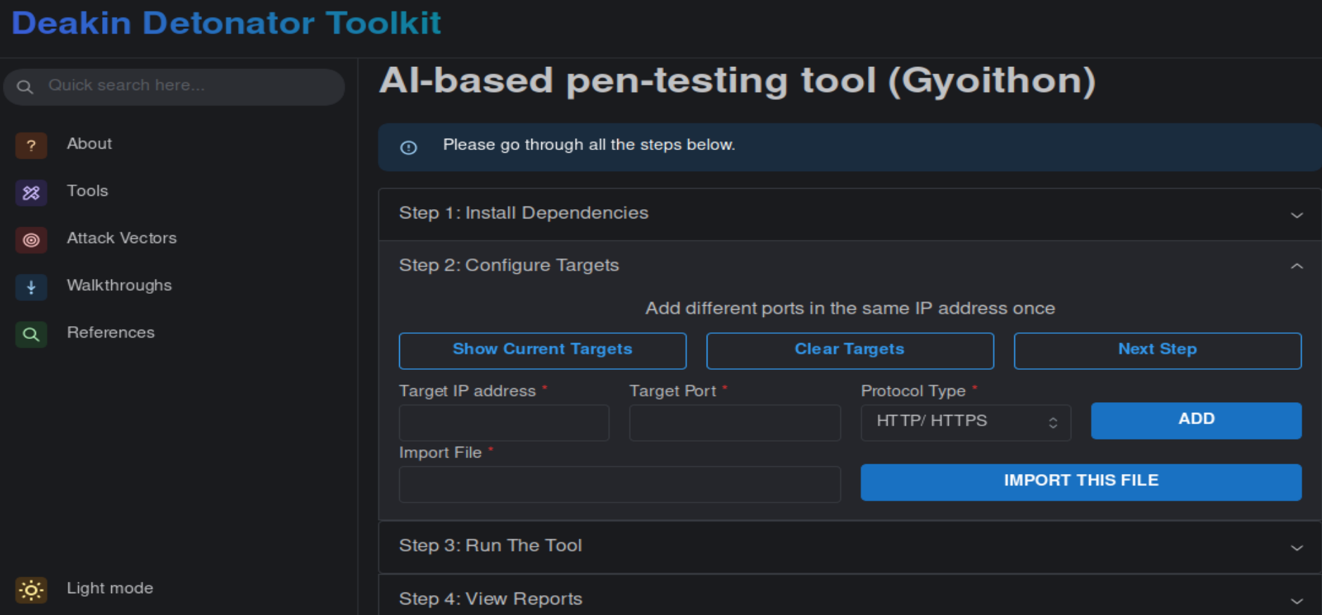
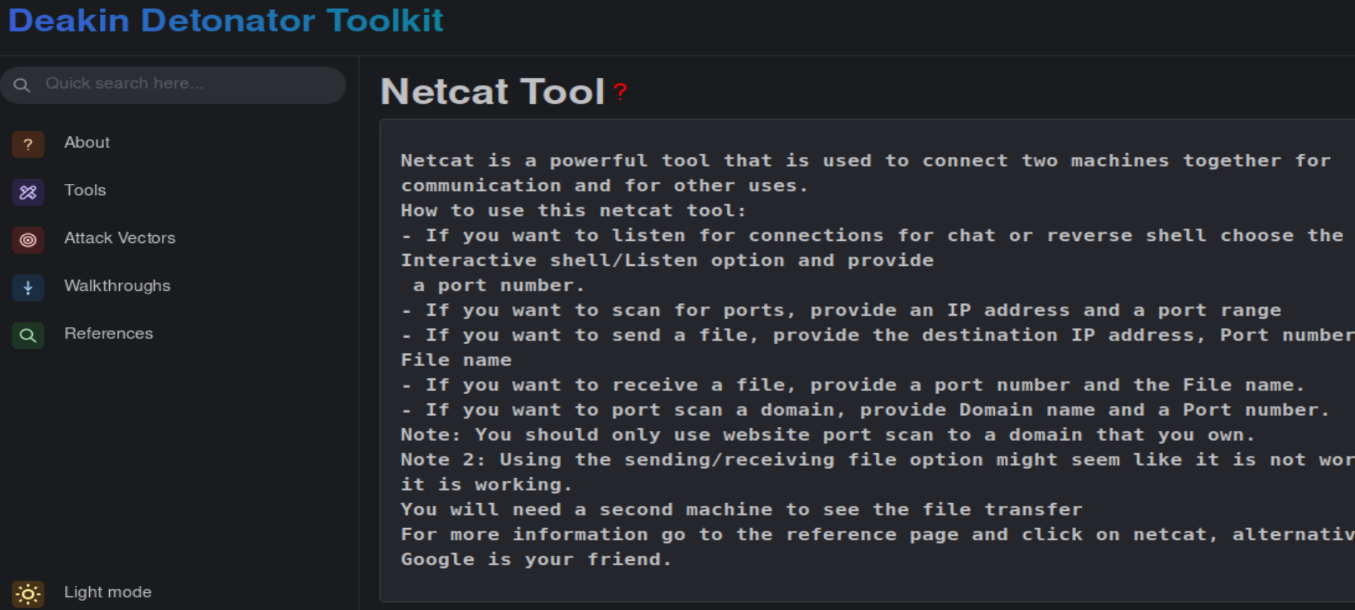
Pen-Testing GUI Progress Update
Exploit development
4 tools implemented: Cewl, DNSmap, Netcat, DNSenum.
2. An AI based pen-testing tool with improved algorithms is implemented.
Function validation
Streamlined the process of adding walkthrough videos through a quick add button.
Document
The MVP of build-in UserGuide is implemented and integrated on 6 tools

Slide 8
Breaking Captcha Progress
Prototype:
Built a prototype using Balsamiq
Created 11 pages including homepage, user registration, login, password reset, access control, object detection, text detection, and voice detection
Website:
Completed user registration page with unique usernames and passwords
Created login/logout feature with password reset link
Implemented access control and navbar
Homepage displays most recent comments
AI Progress:
Translated previous team's audio model from Pytorch to TensorFlow
Created 70% and 85% accurate image recognition models using VGG16
Created Faster RCNN, YOLO, and DETR image recognition models
Working on packaging a text recognition model for back-end

Slide 9

Q/A
Notes:
That is the end of the presentation. My team and I are happy to answer any questions you guys may have.

Slide 10
Company Goals
Provide students with an engaging learning experience.
Allow students to gain wide project experience enabling them to share their expertise with others outside of their project team.
Mature the existing projects –AppAttack, Breaking CAPTCHA, Fortify, NASA Protocol Exploits and PT GUI.
Enable the projects to continue into future trimesters, allowing students to hone their skills.
Continue to promote the open-source project concept enabling students to showcase to prospective employers.

